Slide 1
Electrical and Computer Engineering Department
University of Victoria
Proximity Effect in EBL
by:
Abhay Kotnala
January 2013

Slide 2
Outline
Introduction
Proximity Effect: A Physical Insight
Proximity Effect:Avoidance& Correction
Conclusion
References

Slide 3
Introduction
“Encyclopaedia Britannica on head of a pin”
Proximity Effect is inherent problem associated with EBL
Studied extensively theoretically and experimentally

Slide 4
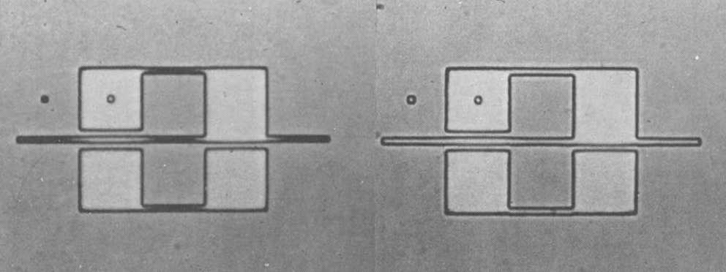
Proximity Effect
The proximity effect is the change in feature size of pattern as a consequence of non uniform exposure in regions adjacent to those addressed by the electron beam
Pattern affected by proximity (left), After elimination of proximity effect (Right)

Slide 5
Consequences
Limits the resolution of EBL
Imposes restriction on the size and shape of the structures
Other Effects
Corners in the desired pattern become rounded
Gap spacing and line width are modified
Features may merge together or disappear completely

Slide 6
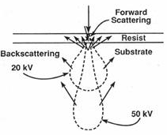
Electron Interactions: A Physical Insight
Electron enter the resist and penetrate further into the substrate
Types
Forward Scattering
Backward Scattering

Slide 7
Continued
Forward Scattering
Inelastic scattering
Small Scattering angle
Widening of the electron beam
Small contribution to proximity effect
Backscattering
Elastic scattering
Large scattering angle
Additional exposure to the resist in adjacant areas
Large contribution to proximity effect

Slide 8
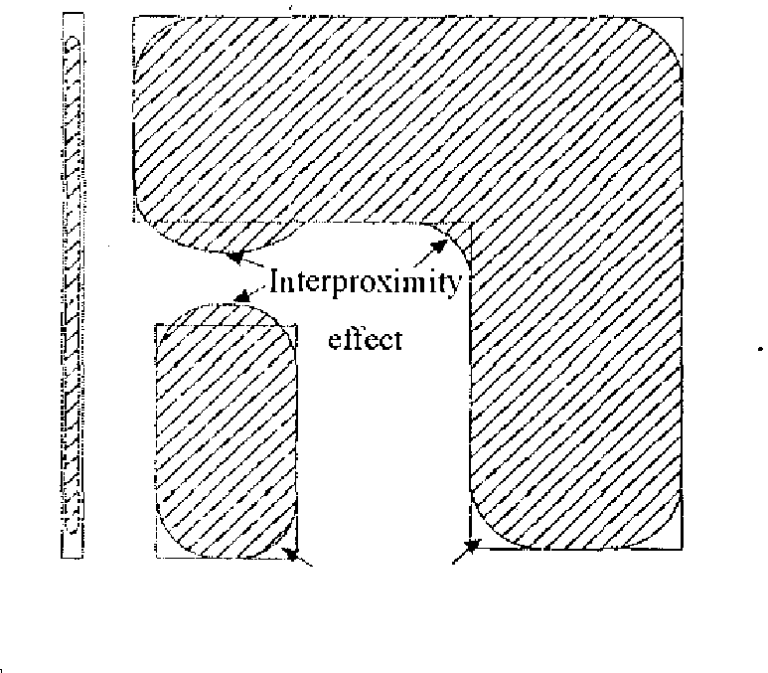
Proximity Effect(Revisited)
Direct consequence of Electron Scattering
Nonuniform distribution of actually receieved exposure by the incident electron beam
Two types of proximity effect
Intraproximity Effect
Interproximity effect

Slide 9
Avoidance and Correction
Improved/Optimized Mask Design
Optimize Exposure and Development condition
Effective process measure
High energy electron beam
Thin resist
Low atomic number substrate
Thin substrate
Multilayer resist processes
Utilize proximity correction software
Exposure dose modulation
Shape dimension adjustment technique

Slide 10
Conclusion
Most challenging problem in e-beam lithography
The physical phenomenon of electron scattering responsible for proximity effect.
There exists a trade-off in proximity effect correction between speed, complexity and accuracy.

Slide 11
References
Chang, T. H. P. (1975). "Proximity effect in electron-beam lithography." Journal of Vacuum Science and Technology 12(6): 1271-1275.
Browne, M. T., P. Charalambous and V. A. Kudryashov (1991). "The proximity effect in electron beam nanolithography." Microelectronic Engineering 13(1–4): 221-224.
Mark A. McCord and Michael J. Rooks. Electron beam lithography. In P. Rai Choudhury, editor, Handbook of Microlithography, Micromachining, and Microfabrica-tion, volume 1, chapter 2. SPIE Optical Engineering Press, London, 1997.

Slide 12
Thank you

